Slide 1
AIML CA1
Classification
Name: Lim Yu Yang Ian
Admin No: 2201874
Class: DAAA/FT/2A/02

Slide 2
Objective
Information
Background
Allow banks to predict if customers will default on their payments
Defaulting is the failure to make required interest or principal repayments on a debt.
Banks collate data on their customers, in order to help identify things like credit score, and in this case, predict if a customer will default.

Slide 3
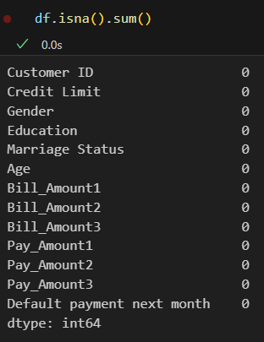
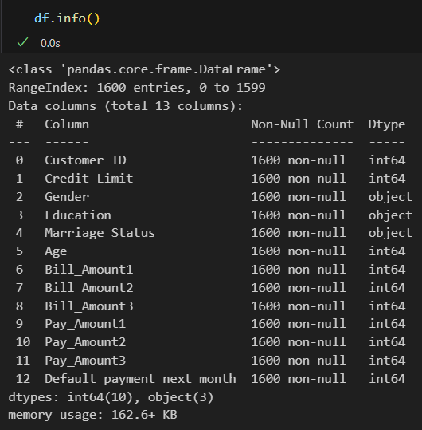
Data Observations
Here we can see that there are no Null Values in the dataset, thus we do not need to do drop any rows or use any alternatives to handle the Null values
Here we can see the type of each column. Our target attribute here would be the Default payment next month column.
We can also see that there are 1600 entries in this dataset, which is a very small amount of data.

Slide 4
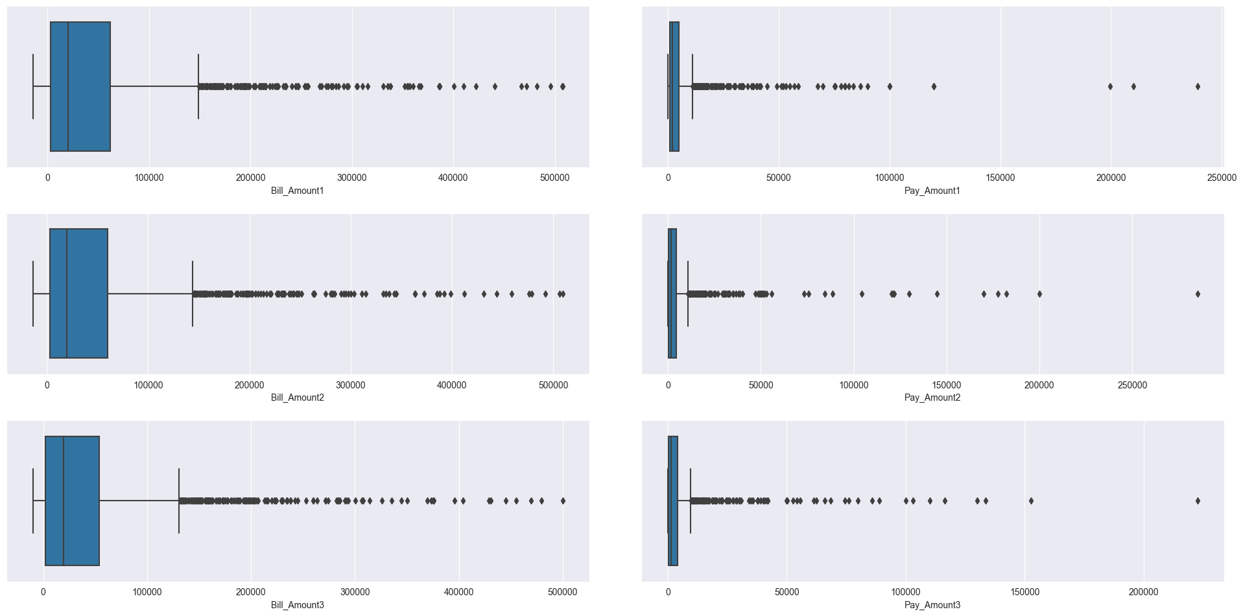
Data Observations
As shown here, for Bill/ Pay amounts, there is a lot of outliers. The data is also very skewed to the left.

Slide 5
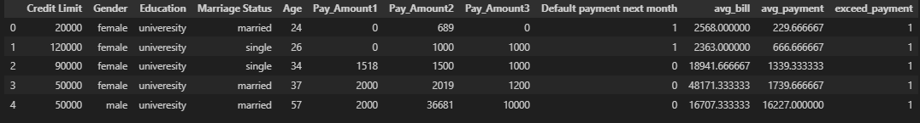
Feature Engineering
Added:
Avg_bill: The average bill of the 3 months
Avg_payment: The average payment of the 3 months
Exceed_payment: A boolean, of whether Avg_bill > Avg_payment
Dropped:
Bill_Amount1/2/3: Had too high a correlation
Customer ID: No correlation

Slide 6
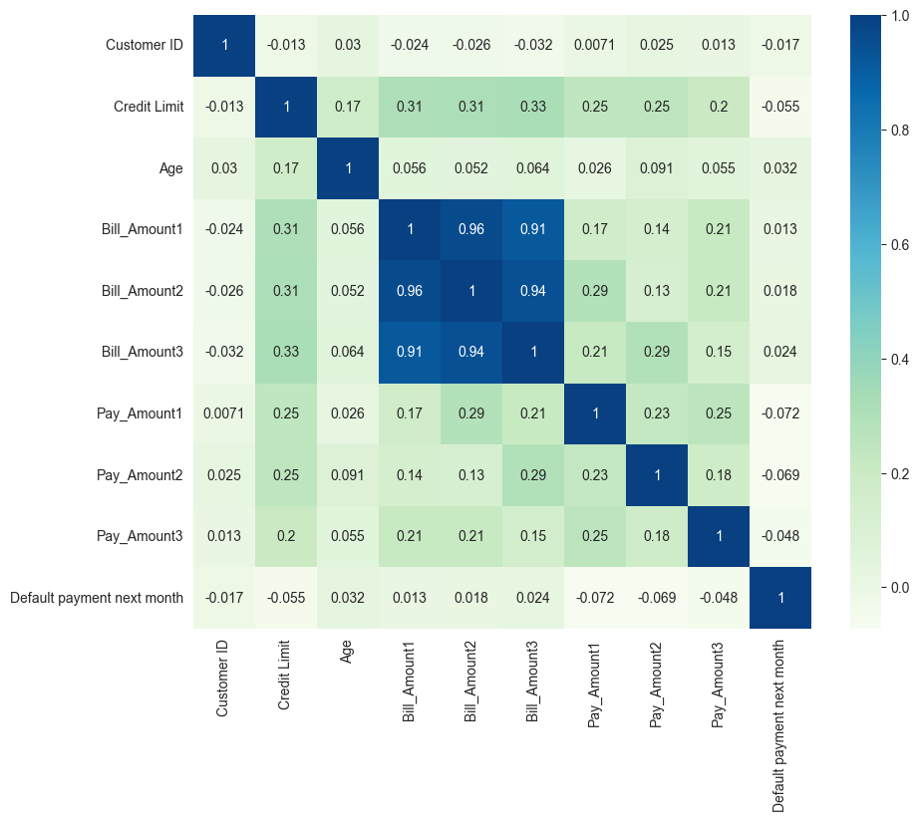
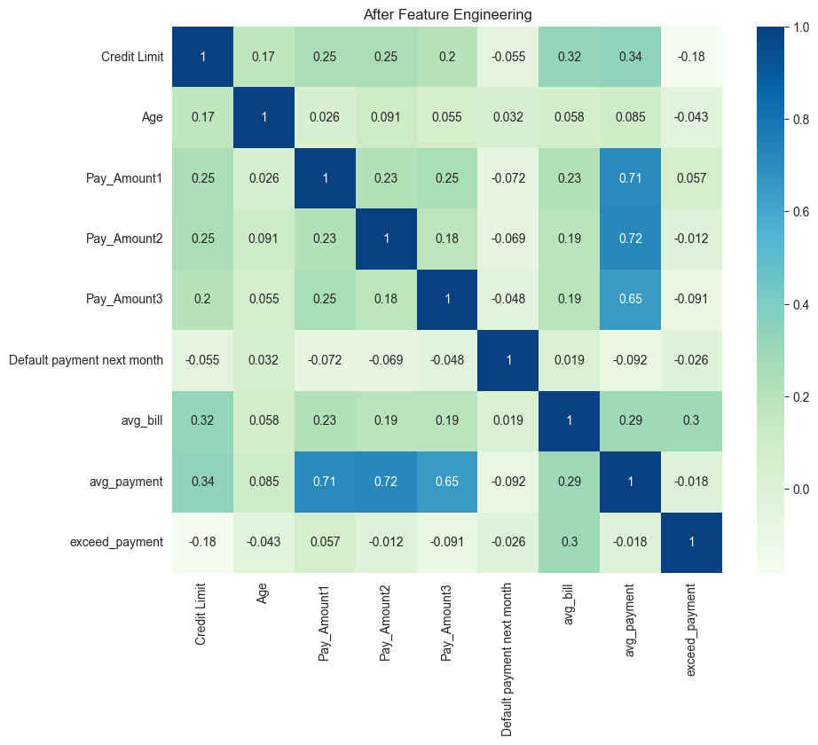
Correlation
Before
After

Slide 7
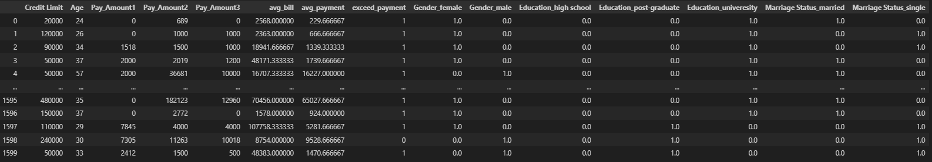
Encoding
I use One Hot Encoding (OHE) to encode my categorical data.
My categorical data does not have a large number of categories, and thus makes OHE appropriate to use.
I also split my data into 70% for training, and 30% for testing

Slide 8
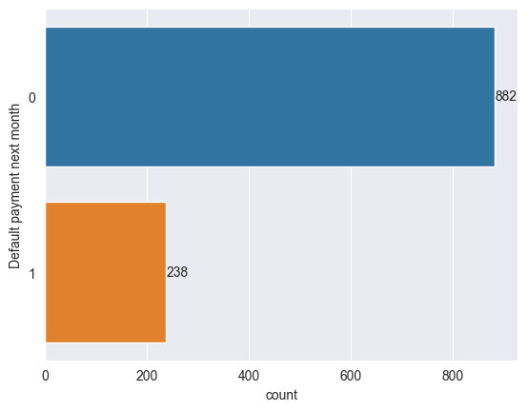
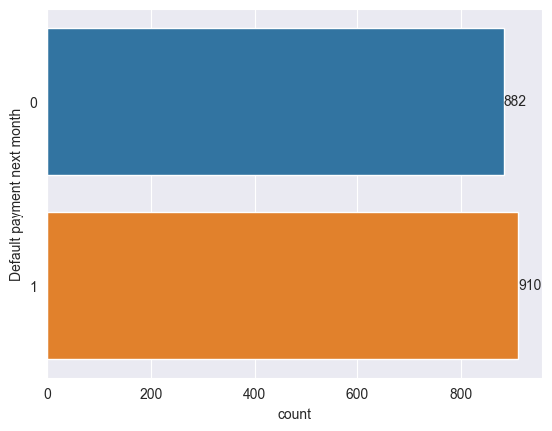
Oversampling
There are 3 methods used to Oversample. I use ADASYN as my dataset is highly imbalanced.
I also use it as it tends to be more adaptive than SMOTE or ROS
Before
After

Slide 9
Standard Scaling
I use standard scaling to make it easier for my model to work.
Above is the output of my train data after being Standardized

Slide 10
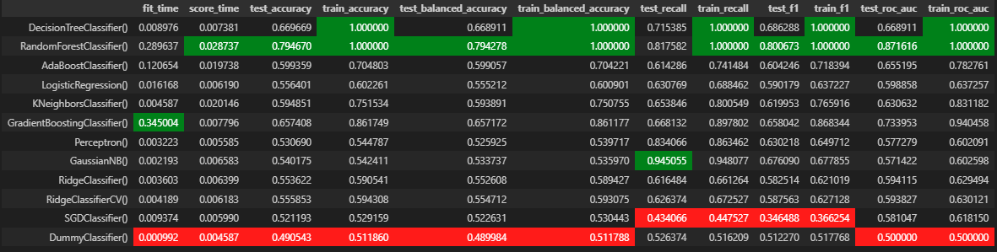
Model Selection
After running all my models, using the cross_validate function, I get the values below.
I will be using F1 as my scoring metric. This is as it takes both recall and precision into account.
Based on F1 score alone, we can see that Gradient Boosting, Decision Tree, and Random Forest have the highest F1 scores.

Slide 11
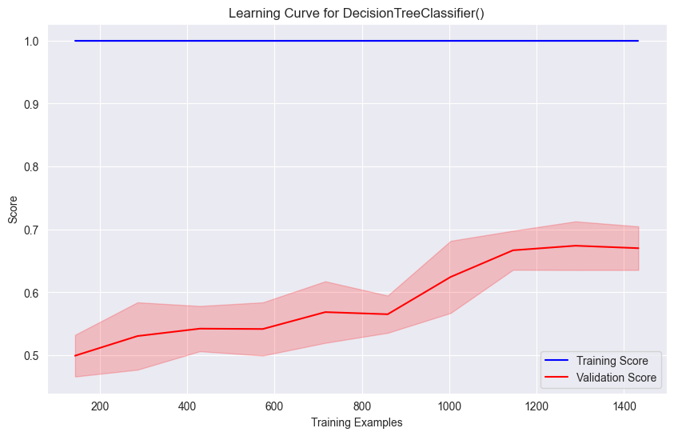
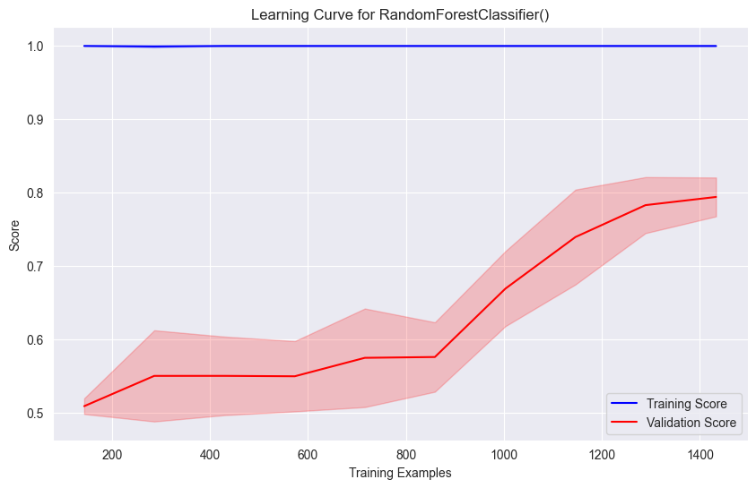
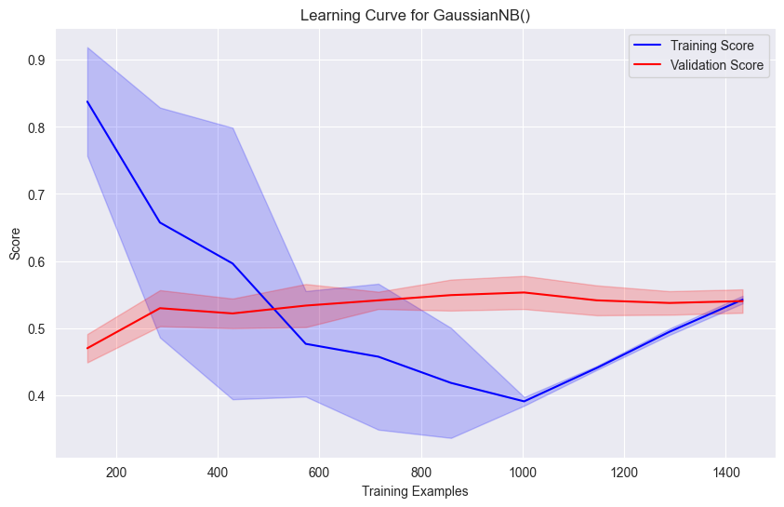
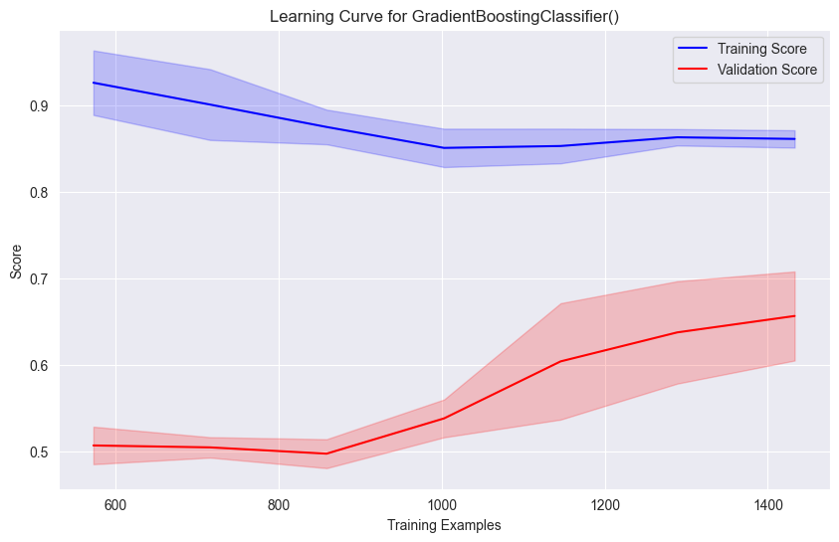
Learning Curves
Using the learning curves function, I plotted these graphs. These help me to narrow down the models I should select.
From the below. I have concluded to eliminate GaussianNB.
Decision Tree.
Good learning curve.
Random Forest.
Good learning curve.
GaussianNB
Bad learning curve
(Training score is very sporadic)
Gradient Boosting.
Good learning curve.

Slide 12
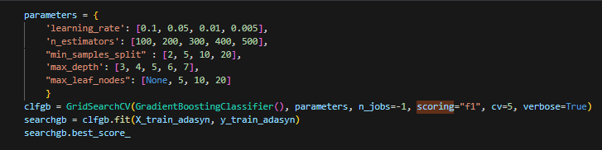
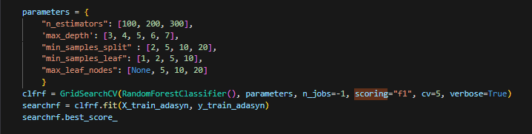
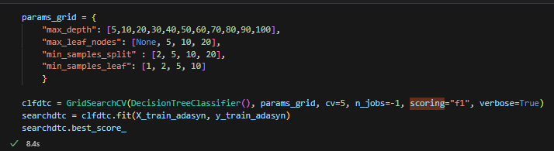
Hyper Tuning
I use the following parameters:
Gradient Boosting:
Learning_rate
n_estimators
min_samples_split
max_leaf_nodes
Random Forest:
n_estimators
max_depth
min_samples_split
min_samples_leaf
max_leaf_nodes
Decision Tree:
max_depth
min_samples_split
min_samples_leaf
max_leaf_nodes

Slide 13
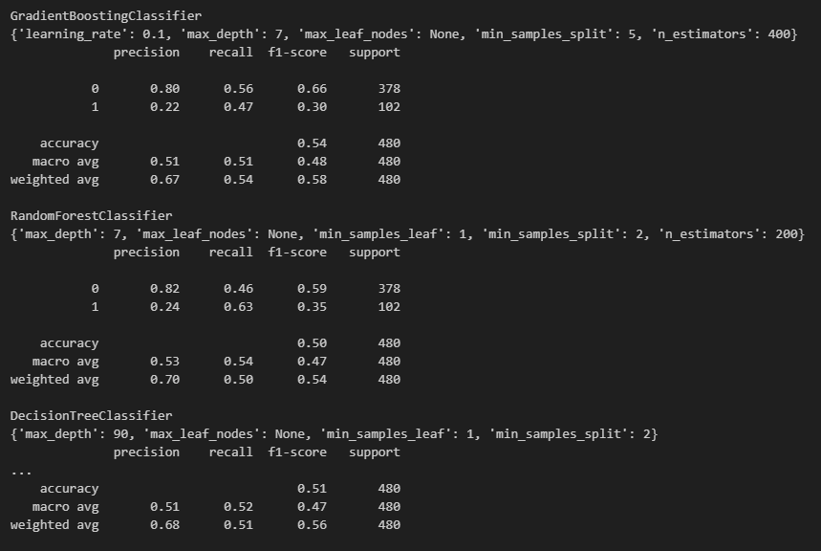
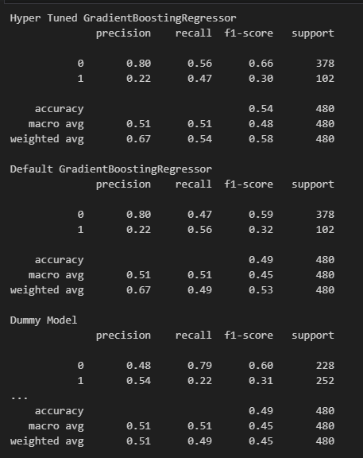
Final Model
We can view the best parameters of each hyper tuned model.
From here, we can see that
Gradient Boosting Classifier has the highest weighted average of F1-score.
Thus I will select this as my final model with the best parameters.
From the bottom image, we can see how the hyper tuned gradient boosting regressor improves the F1 score over the default and the dummy model.

Slide 14
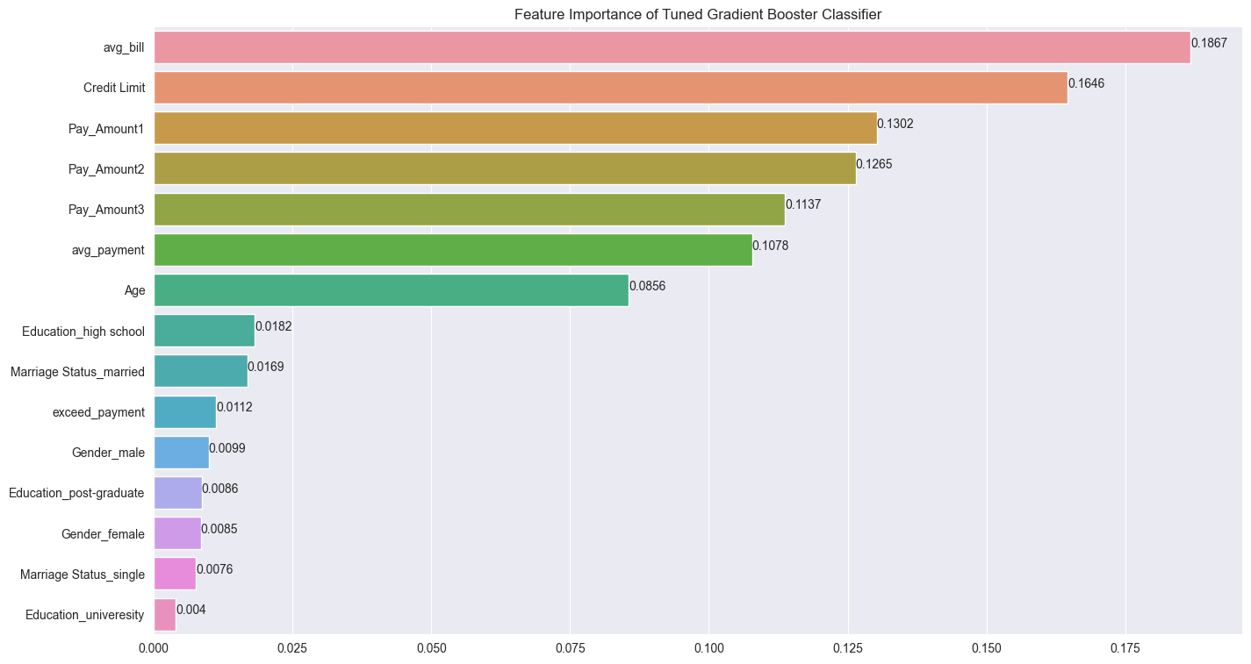
Feature Importance
We can see here that average bill, and credit limit are the most important features of my model.
Engineered Features:
Good:
Avg_bill (18%)
Avg_payment (10%)
Bad:
Exceed_payment (1%)

Slide 15
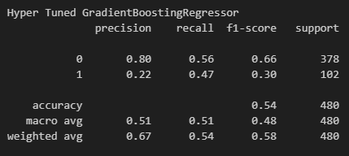
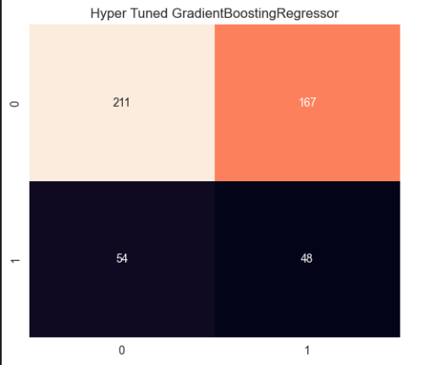
Summary
The confusion matrix has a lot of False positives. Where the model predicts falsely that a customer will default.
We have successfully made a model that can predict the outcome of whether a customer will default or not on their next payment.
We managed to receive an f1 weighted average score of 0.58. And concluded this with the hyper tuned Gradient Boosting Classifier.
However, the model still has areas to improve, and it currently faces some limitations, mainly due to the dataset size and quality.
For the model to be fully deployed, I believe that it is necessary to collect more data so that the model has more to train and test on.

